Slide 1
Potential malaria morbidity and mortality avertable by the President’s Malaria Initiative (PMI) in 2025
Zenabu Suboi
31st March, 2025

Slide 2
Background

Slide 3

Source: BBC news

Slide 4
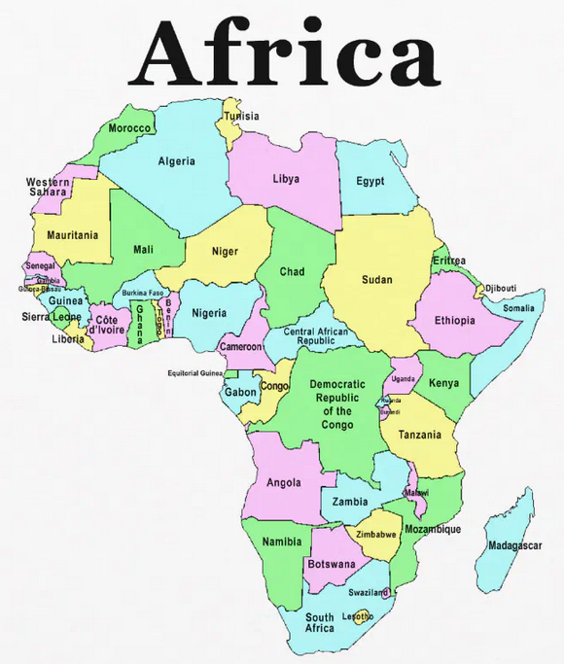

Background

Slide 5

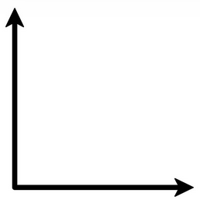

Background
Malaria deaths
2002
805’000
569’000
2005
2000
2023
Year

Slide 6




Background
ACTs
ITNs
IRS
SMC

Slide 7
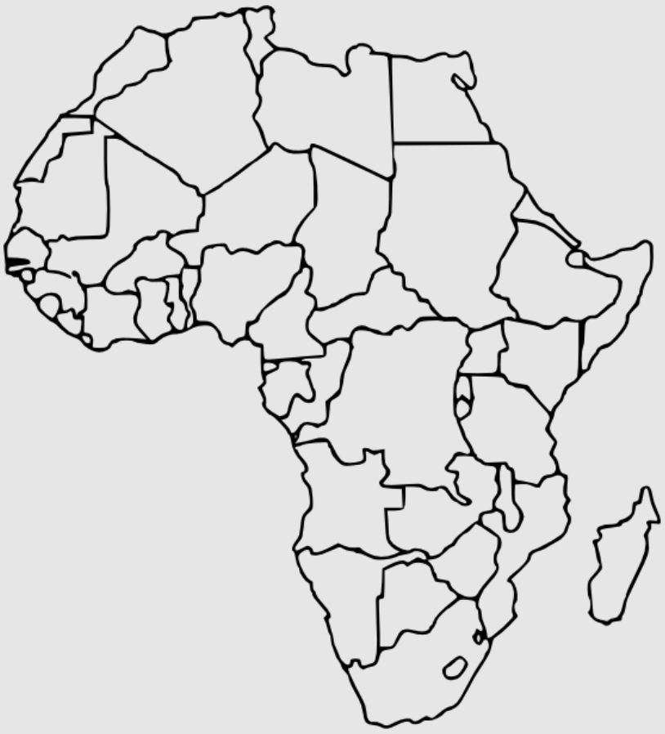
Background - PMI focus countries in Africa
27 African countries

Slide 8
Problem
Immediate and longer-term future of PMI is uncertain

Slide 9
Problem
Immediate and longer-term future of PMI is uncertain
presence or absence of PMI financing has the potential to significantly impact total malaria burden in Africa.

Slide 10
Problem
Immediate and longer-term future of PMI is uncertain,
the presence or absence of PMI financing has the potential to significantly impact total malaria burden in Africa.
Estimates of the overall potential impact of PMI in 2025 can help inform ongoing decision making.

Slide 11
Methods

Slide 12




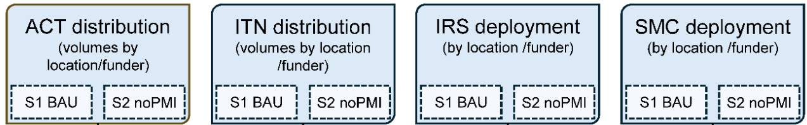
Methods
Stage 1

Slide 13
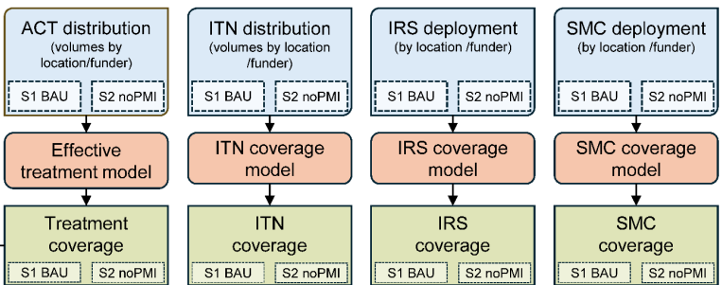
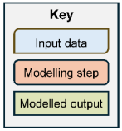
Methods
Stage 2

Slide 14
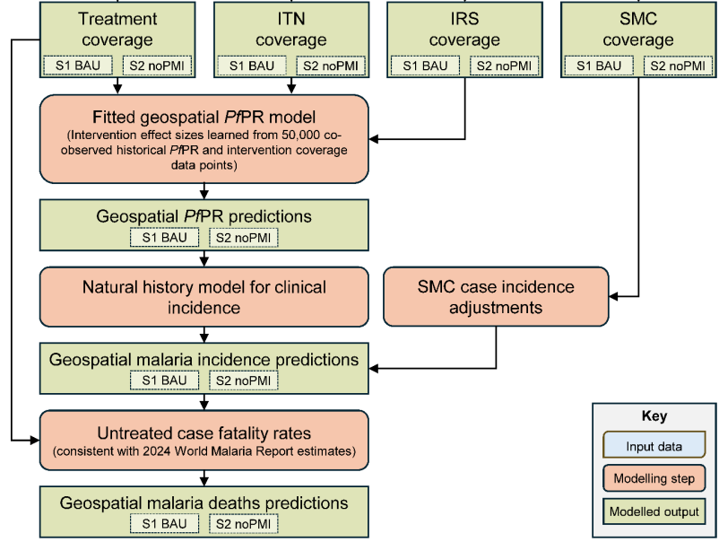
Methods
Stage 3
Stage 4
Stage 5

Slide 15
Results

Slide 16
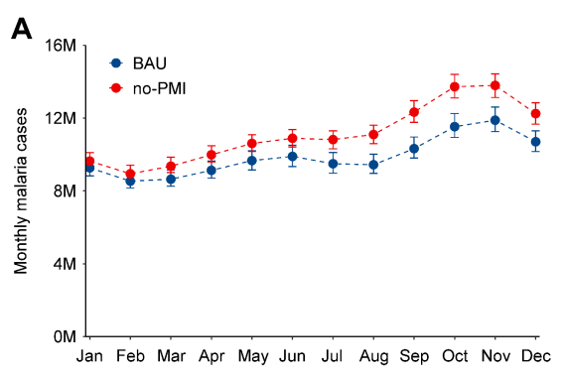
Results - Monthly malaria cases (2025)

Slide 17
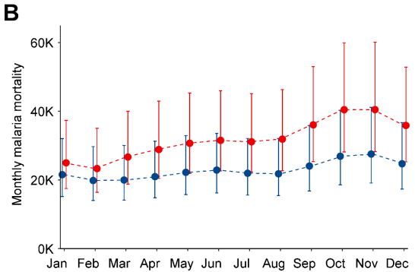

Results - Monthly malaria deaths - (2025)

Slide 18
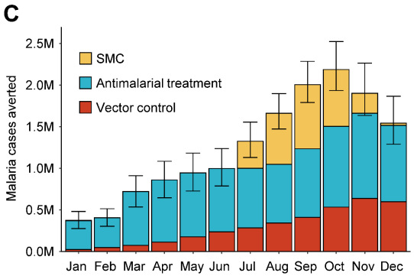
Results - Monthly malaria cases averted by PMI (2025)

Slide 19
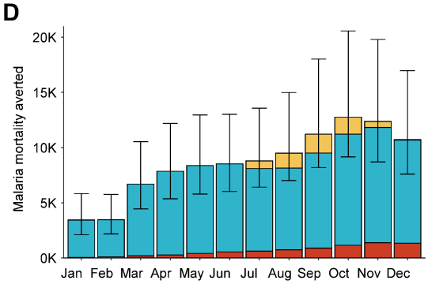
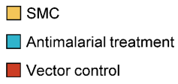
Results - Monthly malaria deaths averted by PMI - (2025)

Slide 20
Conclusion

Slide 21
Conclusion
PMI support is critical

Slide 22
Conclusion
PMI support is critical
PMI saves around 15M malaria cases
averts around 100,000 malaria deaths

Slide 23


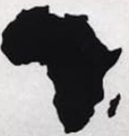
Take home message
ACTs

Slide 24
Thank you for your attention
Reference:
Symons, Tasmin L., et al. "Estimating the potential malaria morbidity and mortality avertable by the President's Malaria Initiative in 2025: a geospatial modelling analysis." medRxiv (2025): 2025-02.

